Slide 1
Natalia Manola
Athena Research and Innovation Center
OpenAIRE MANAGING DIRECTOR
TDM as in infrastructure in the EOSC
OpenMinted: USE CASE & lessons learned
VISA TM | NOV 15, 2019 | PARIS
@openminted_eu

Slide 2
PART I
European open science cloud
@openminted_eu

Slide 3
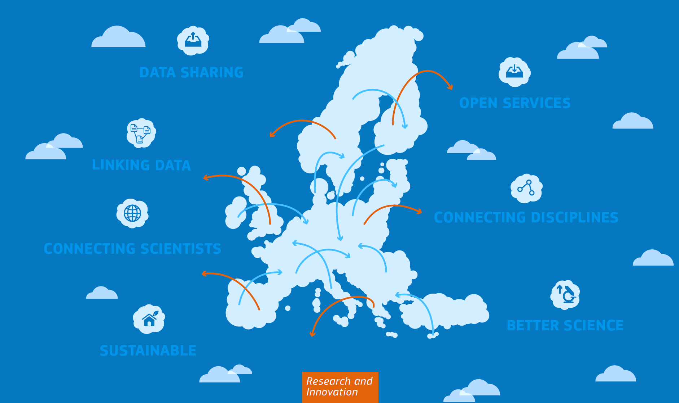
“1.7 million European researchers and 70 million professionals in science and technology a virtual environment with free at the point of use, open and seamless services for storage, management, analysis and re-use of research data, across borders and scientific disciplines”

Slide 4
EOSC key characteristics
Trusted and open virtual environment with seamless access to services (with highest TRLs) addressing the whole research
Multi-layered federation which brings together supply and demand in a trusted environment
Open, transparent, rule of law based: no lock-in by individual service providers, data portability, IPR, cloud security…
Adaptively user-oriented and inclusive, across borders and disciplines
Governed by a minimal set of Rules of Participation
Steered by an inclusive governance structure
It’s the glue that binds together data, services, people
It’s about making data smart and actionable
An Open Research Commons
VISA TM | NOV 15,2019 | PARIS

Slide 5
PART ii
Text mining ecosystem
Focussing on scholarly outputs and scientific knowledge
@openminted_eu

Slide 6
Some facts on scientific literature
How can we make sense of this data?
VISA TM | NOV 15,2019 | PARIS

Slide 7
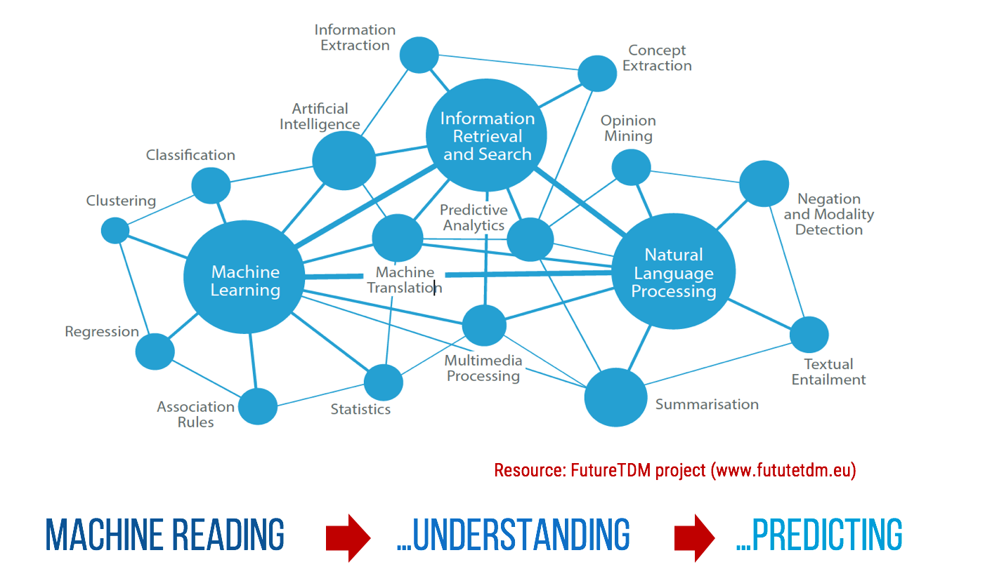
A GLIMPSE ON THE TDM LANDSCAPE
VISA TM | NOV 15,2019 | PARIS

Slide 8
A complex and fragmented Landscape
matchmaking – expertise with needs
Text Mining Researchers
How to approach in a systematic way
Content Providers
In an open way
Computing Infrastructures
End Users
In the context of EOSC, HPC, AI
Smart & Actionable research data
VISA TM | NOV 15,2019 | PARIS

Slide 9
PART III
The components
An infrastructural approach
@openminted_eu

Slide 10
the components of OpenMinted
Content
Proces
guidelines.openminted.eu
DI4R @ Brussels - Dec 1, 2017

Slide 11
The challenges
Sharing content
Sharing services
Deploying services
common access
IPR and licensing
Share in a meaningful way: what does Open Access really mean?
Access mechanisms
No standard formats metadata
No standard APIs for full text access
Deploying mechanisms
Different ways to retrieve and deploy services: web services, docker, maven
Capacities
Cloud capacities
Non uniform computing and storage stacks
AAI
Linking different infrastructures, with different requirements
A small scale EOSC
IPR and licensing
Service to service interaction
Interoperability
No standard way to document services or workflows
No common way to represent annotated results
VISA TM | NOV 15,2019 | PARIS

Slide 12
PART iV
The OpenMinted platform
Addressing key challenges – First attempt towards a TM infrastructure
@openminted_eu

Slide 13
OpenMinted
EC H2020 PROJECT
2015-2018
6 mi
VISA TM | NOV 15,2019 | PARIS

Slide 14
Services
An Actionable Service/tool catalogue
A Shared Content hub - FAIR publications
A cloud processing environment
A workflow editor and engine
A Publishing mechanism for Sharing ANNOTATED CORPORA
VISA TM | NOV 15,2019 | PARIS

Slide 15
Who openminded is FOR?
Consumers
Domain specific researchers & research communities
Application developers / RI data scientists
Infrastructure operators
Providers
For Content
Publishers and repository managers (research libraries)
For services
Expert language technology
Non NLP expert developers
A bridge between text miners to domain researchers
VISA TM | NOV 15,2019 | PARIS

Slide 16
Proposed solution : Make TDM enabled hubs
AAI
PIDs
OpenAIRE + OpenMinTeD
Guidelines
APIs
Literature Repositories
OpenAIRE
OA Journals
Metadata
CORE
Archives
Aggregators
Full text
Data
PMC Europe
TDM
Data Repositories
…
Research networks
Open Data
Open Protocols
COMPUTING RESOURCES
REPOSITORIES
STORAGE
…
WIkiPedia/Media/Research
VISA TM | NOV 15,2019 | PARIS

Slide 17
PART v
OpenMinted in action
TRL6/7 services
@openminted_eu

Slide 18
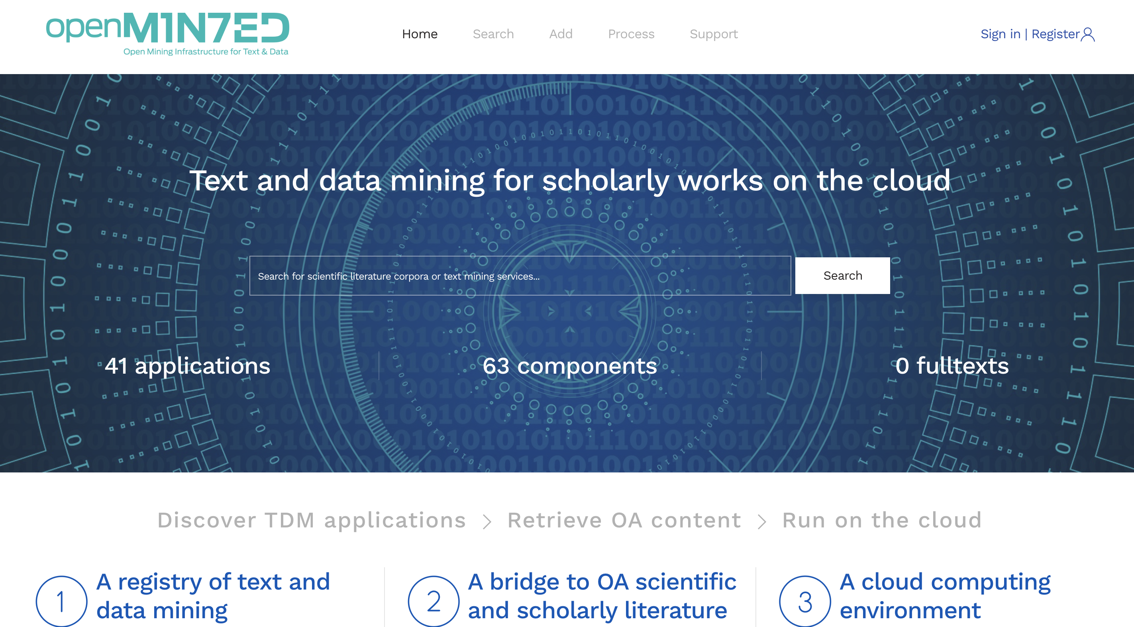
SERVICES.OPENMINTED.EU (TRL 6/7)
Storing results in zenodo
Viewing annotations
REAL TIME Building corpora:
OpenAIRE
CORE
Running a service
Uploading OWN corpora
Registering a service
VISA TM | NOV 15,2019 | PARIS

Slide 19
PART vI
Next steps
@openminted_eu

Slide 20
What we aim for
A pre-registry for EOSC allow sharing of services and content
With openness and transparency in the center
A hub to link to external services
RoP based for data portability, IPR, SLAs, cloud security…
User-oriented providing end-to-end solutions
National/thematic installations for a commons approach
Steered by a community based governance structure
Robustness, performance, closing the open science loop
VISA TM | NOV 15,2019 | PARIS

Slide 21
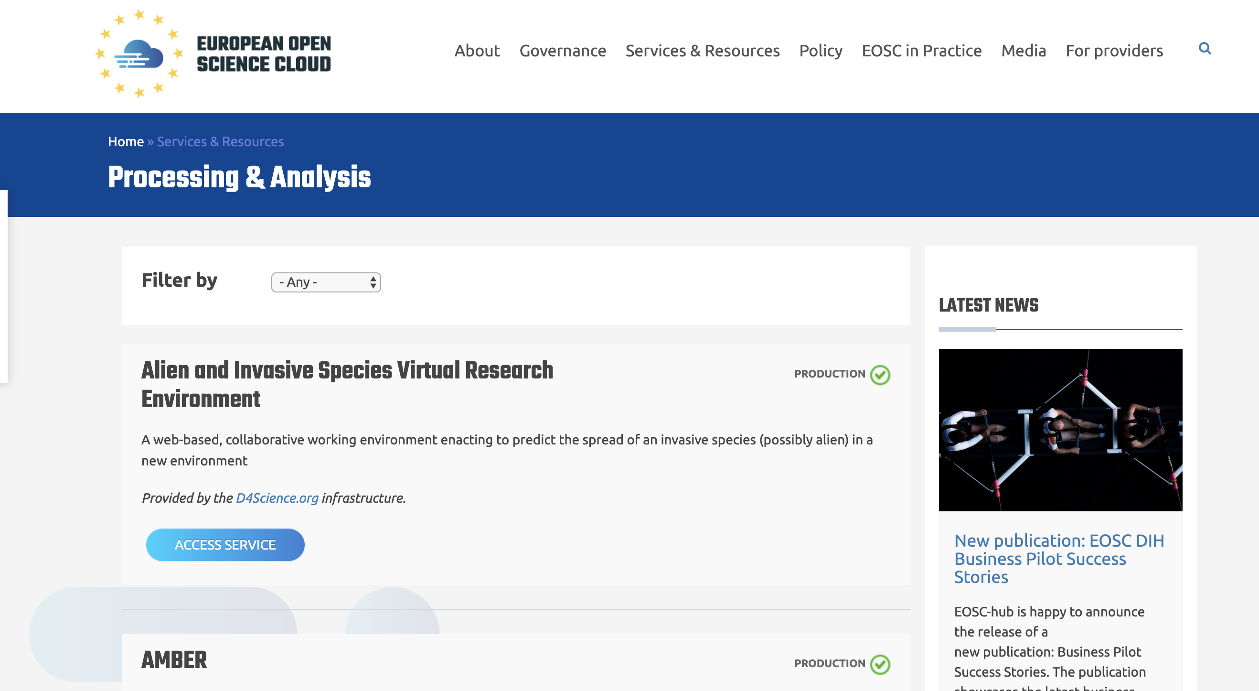
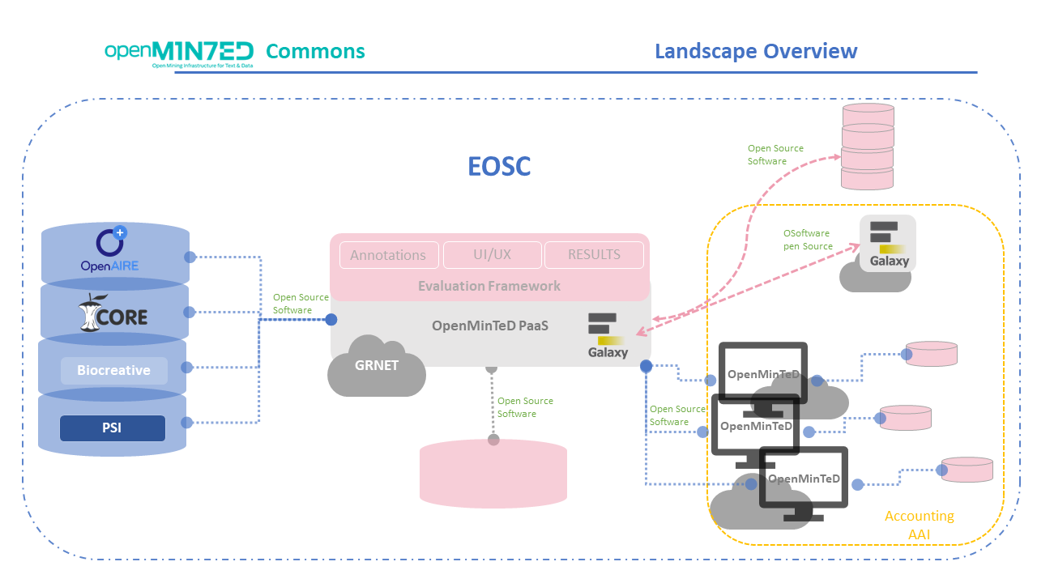
TOWARDS A COMMONS - EOSC
VISA TM | NOV 15,2019 | PARIS

Slide 22
@openminted_eu
THANK YOU!
Questions?
Natalia Manola
natalia@di.uoa.gr

